Slide 1

Mini Project 3 Mini Chess AI
Due: …

Slide 2
Outline
Introduction
Chess and Mini Chess
State Value Function
Minimax
Alpha-Beta Pruning
How To Design Your AI
Package
Requirements
Grading

Slide 3
Outline
Introduction
Chess and Mini Chess
State Value Function
Minimax
Alpha-Beta Pruning
How To Design Your AI
Package
Requirements
Grading

Slide 4
Introduction
Design and implement an AI which can play MiniChess
Read the current board and output the next move
Design a state value function to evaluate the score of the board
Determine the next move with tree search algorithm

Slide 5
Outline
Introduction
Chess and Mini Chess
State Value Function
Minimax
Alpha-Beta Pruning
How To Design Your AI
Package
Requirements
Grading

Slide 6
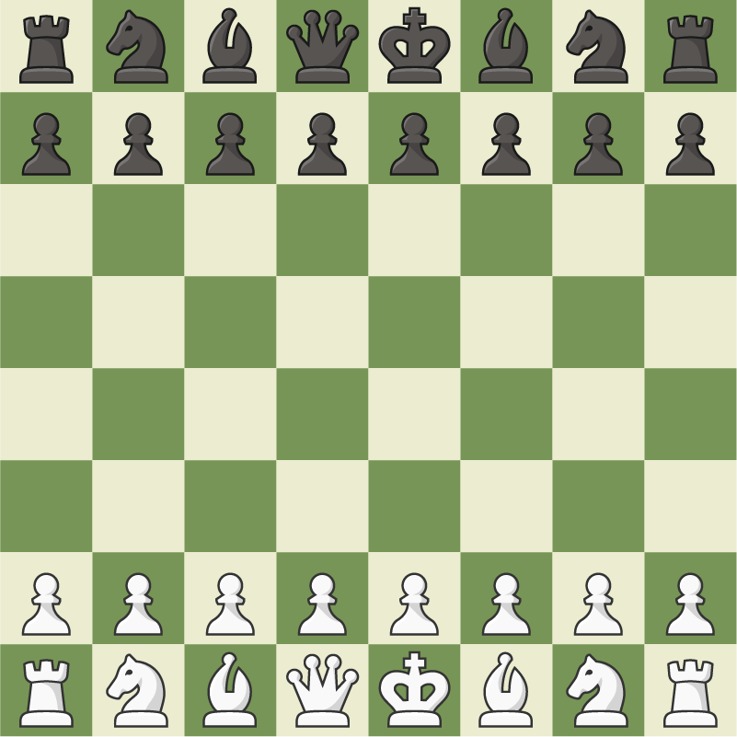
Chess

Slide 7
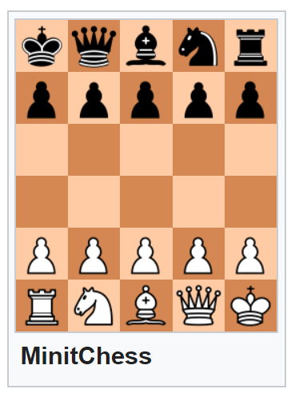
Mini Chess
Has lot of variance.
We use “MinitChess” in this project

Slide 8
Basic rules
We have 2 player: white and black. White play first.
If the target place of your piece has opponent’s piece, you can take it out (or, catch the piece), You cannot take your own piece.
If a player can catch opponent’s king in its turn, it win.
So a player can only win in its turn or lose in opponent’s turn.
If a player make an illegal move, it lose.
Our rule is simplified, any different rules will be marked as red one:
There is no castling
Pawn can only promote to Queen (detail on next section)

Slide 9
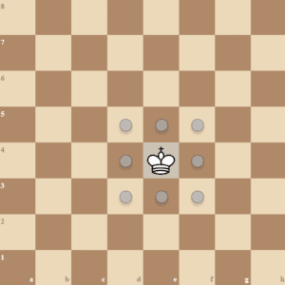
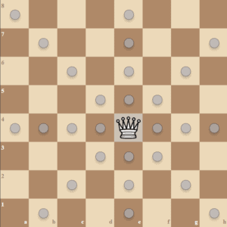
Piece Movement
King and Queen

Slide 10
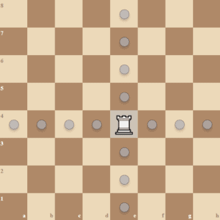
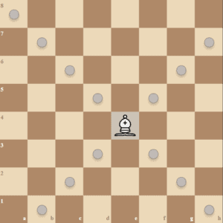
Piece Movement
Rook and Bishop

Slide 11

Piece Movement
Knight
Knight can “jump over pieces”
It cannot be blocked

Slide 12
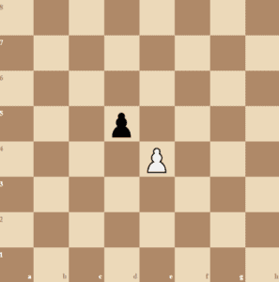
Piece Movement
Pawn
Every turn, pawn can move forward one step.
Even in the first move of that pawn.
With ↑ this rule, there is no En passant.
If left/right forward is opponent’s piece, you can catch it.
When a pawn move to the last row (6 for white, 1 for black), it become Queen (promotion).
Promotion and Move to Last Row will happened simultaneously.

Slide 13
Outline
Introduction
Chess and Mini Chess
State Value Function
Minimax
Alpha-Beta Pruning
How To Design Your AI
Package
Requirements
Grading

Slide 14
State Value Function
The program should decide which move is better
We can pick the move which leads to the board with highest score
Thus, we need a function to evaluate the score of the board
It is the “state value function”

Slide 15
State Value Function
State => the board
Value => how “good” the board is
Function => given a board, output the value

Slide 16
State Value Function
Super simple Example:
Give every piece a score (king=inf, queen=100, …)
Your pieces – Opponent’s pieces = value of the state.
Some upgrade:
A piece in different place has different value.

Slide 17
State Value Function
Keywords for more complicated algorithm:
KP (King-Piece), PP (Piece-Piece), KPPT (King-Piece-Piece-Turn)
KKPT (King-King-Piece-Turn with King-Piece-Piece)
MCTS (Monte Carlos Tree Search)
AlphaZero
Leela Chess Zero
NNUE (Efficiently Updatable Neural Network)
This is the SOTA for Chess and Shogi
Stockfish (2022 TCEC 1st place, 2022 CCC 1st place)
水匠 (第3回世界将棋AI電竜戦優勝)

Slide 18
Use value function to pick the next move
Suppose we have three valid moves, A, B, and C:
Current
Move A
Move C
Move B
After
Move A
After
Move B
After
Move C

Slide 19
Use value function to pick the next move
After evaluating the state values, we have 20, -15, and 30
Current
Move A
Move C
Move B
Value
20
Value
-15
Value
30

Slide 20
Use value function to pick the next move
We pick move C to be our next step since it leads to the highest value
Current
Move A
Move C
Move B
Value
20
Value
-15
Value
30

Slide 21
Outline
Introduction
Chess and Mini Chess
State Value Function
Minimax
Alpha-Beta Pruning
How To Design Your AI
Package
Requirements
Grading

Slide 22
Minimax
In the previous example, we only look forward for one step
However, the opponent will try its best to defeat you
Greedy choice is not always the best
We should look forward for more steps and simulate how the opponent thinks to make the best choice with least risk

Slide 23
Minimax
Player tries its best to win
Player picks the move with the highest score
Opponent tries its best to defeat the player
Opponent picks the move with the lowest “player’s value function” score
That is, opponent tends to give the player the worst board
The Minimax algorithm is based on this player-opponent interaction

Slide 24
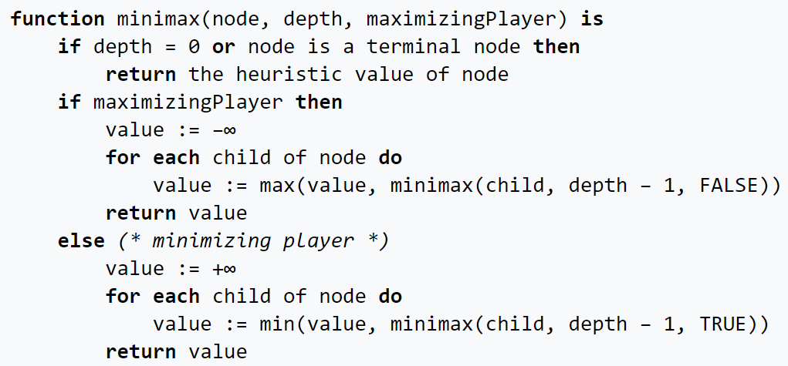
Minimax Pseudocode
Source: https://en.wikipedia.org/wiki/Minimax

Slide 25
Example
Now
:Player
:Opponent
A
B
C
D
E
F
G
H
I
J
K

Slide 26
Evaluate score at leaves
Now
:Player
:Opponent
A
B
C
D
E
F
G
H
I
J
K
5

Slide 27
Evaluate score at leaves
Now
:Player
:Opponent
A
B
C
D
E
F
G
H
I
J
K
5
6

Slide 28
Player picks the largest score
Now
:Player
:Opponent
A
B
C
D
E
6
F
G
H
I
J
K
5
6

Slide 29
Evaluate score at leaves
Now
:Player
:Opponent
A
B
C
D
E
6
F
G
H
I
J
K
5
6
7

Slide 30
Evaluate score at leaves
Now
:Player
:Opponent
A
B
C
D
E
6
F
G
H
I
J
K
5
6
7
4

Slide 31
Evaluate score at leaves
Now
:Player
:Opponent
A
B
C
D
E
6
F
G
H
I
J
K
5
6
7
4
5

Slide 32
Player picks the largest score
Now
:Player
:Opponent
A
B
C
D
E
6
7
F
G
H
I
J
K
5
6
7
4
5

Slide 33
Opponent picks the smallest score
Now
:Player
:Opponent
A
B
6
C
D
E
6
7
F
G
H
I
J
K
5
6
7
4
5

Slide 34
Evaluate score at leaves
Now
:Player
:Opponent
A
B
6
C
D
E
6
7
F
G
H
I
J
K
5
6
7
4
5
3

Slide 35
Player picks the largest score
Now
:Player
:Opponent
A
B
6
C
D
E
6
7
3
F
G
H
I
J
K
5
6
7
4
5
3

Slide 36
Opponent picks the smallest score
Now
:Player
:Opponent
A
B
6
3
C
D
E
6
7
3
F
G
H
I
J
K
5
6
7
4
5
3

Slide 37
Move A has the largest score
Now
:Player
:Opponent
A
B
6
3
C
D
E
6
7
3
F
G
H
I
J
K
5
6
7
4
5
3

Slide 38
Player picks move A to be the next move
Now
:Player
:Opponent
A
B
6
3
C
D
E
6
7
3
F
G
H
I
J
K
5
6
7
4
5
3

Slide 39
Outline
Introduction
Chess and Mini Chess
State Value Function
Minimax
Alpha-Beta Pruning
How To Design Your AI
Package
Requirements
Grading

Slide 40
Alpha-Beta Pruning
By Minimax, we can simulate our opponent’s moves and pick a move with minimum risk and maximum value
Looking forward for more steps may improve the policy
However, the size of the search tree may drastically increase with the increase of search depth

Slide 41
Alpha-Beta Pruning
Since we only have limited time, if we hope to increase search depth, we must optimize the search process
There are many branches in the minimax process which is not related to the result
We can try to “prune” these branches to improve efficiency
The Alpha-Beta Pruning is the improved version of Minimax method which eliminates some unnecessary branches

Slide 42
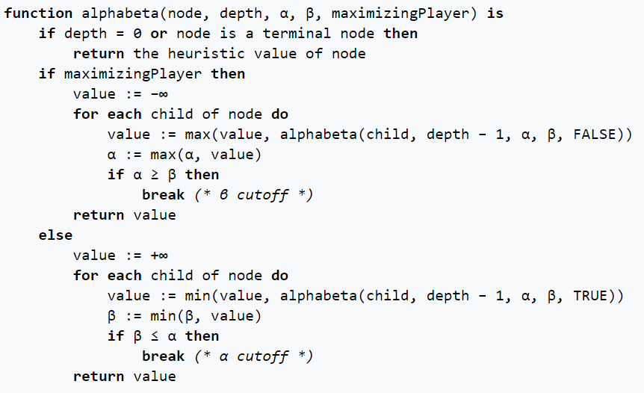
Alpha-Beta Pruning Pseudocode
Source: https://en.wikipedia.org/wiki/Alpha%E2%80%93beta_pruning

Slide 43
Alpha-Beta Pruning
Alpha: the maximum score that the player is assured of in the current search process
Beta: the minimum score that the opponent is assured of in the current search process

Slide 44
Alpha-Beta Pruning
If alpha >= beta on a player node, we can stop to search on this branch
In this situation, the player will return a value >= beta on this branch
However, the opponent already has a better choice (beta)
Thus, no matter the later discovered value on this branch, the opponent will not pick this branch
We can “prune” this branch since it will not affect the result
We can also stop to search if beta <= alpha on an opponent node

Slide 45
Example
Now
α: -INF
β: INF
:Player
:Opponent
A
B
α: -INF
β: INF
C
D
E
α: -INF
β: INF
F
G
H
I
J
K

Slide 46
Evaluate score at leaves
Now
α: -INF
β: INF
:Player
:Opponent
A
B
α: -INF
β: INF
C
D
E
α: -INF
β: INF
F
G
H
I
J
K
5

Slide 47
Update alpha
Now
α: -INF
β: INF
:Player
:Opponent
A
B
α: -INF
β: INF
C
D
E
α: 5
β: INF
F
G
H
I
J
K
5

Slide 48
Evaluate score at leaves
Now
α: -INF
β: INF
:Player
:Opponent
A
B
α: -INF
β: INF
C
D
E
α: 5
β: INF
F
G
H
I
J
K
5
6

Slide 49
Update alpha
Now
α: -INF
β: INF
:Player
:Opponent
A
B
α: -INF
β: INF
C
D
E
α: 6
β: INF
F
G
H
I
J
K
5
6

Slide 50
Player picks the largest score
Now
α: -INF
β: INF
:Player
:Opponent
A
B
α: -INF
β: INF
C
D
E
6
α: 6
β: INF
F
G
H
I
J
K
5
6

Slide 51
Update beta
Now
α: -INF
β: INF
:Player
:Opponent
A
B
α: -INF
β: 6
C
D
E
6
α: 6
β: INF
F
G
H
I
J
K
5
6

Slide 52
Propagate alpha and beta values
Now
α: -INF
β: INF
:Player
:Opponent
A
B
α: -INF
β: 6
C
D
E
6
α: 6
β: INF
α: -INF
β: 6
F
G
H
I
J
K
5
6

Slide 53
Evaluate score at leaves
Now
α: -INF
β: INF
:Player
:Opponent
A
B
α: -INF
β: 6
C
D
E
6
α: 6
β: INF
α: -INF
β: 6
F
G
H
I
J
K
5
6
7

Slide 54
Update alpha
Now
α: -INF
β: INF
:Player
:Opponent
A
B
α: -INF
β: 6
C
D
E
6
α: 6
β: INF
α: 7
β: 6
F
G
H
I
J
K
5
6
7

Slide 55
Alpha >= beta in a player node, stop searching
Now
α: -INF
β: INF
:Player
:Opponent
A
B
α: -INF
β: 6
C
D
E
6
α: 6
β: INF
7
α: 7
β: 6
F
G
H
I
J
K
5
6
7

Slide 56
Opponent picks the smallest score
Now
α: -INF
β: INF
:Player
:Opponent
A
B
6
α: -INF
β: 6
C
D
E
6
α: 6
β: INF
7
α: 7
β: 6
F
G
H
I
J
K
5
6
7

Slide 57
Alpha-Beta Pruning
In the example above, we use the same search tree as Minimax
By pruning, we eliminate branches I and J
However, we still get the same result on branch A
Alpha-Beta Pruning can effectively speed up the process while maintaining the same result

Slide 58
Outline
Introduction
Chess and Mini Chess
State Value Function
Minimax
Alpha-Beta Pruning
How To Design Your AI
Package
Requirements
Grading

Slide 59
How To Design Your AI
The game runner (main.cpp) executes the AIs of the player and the opponent in turns and communicates with them by files
Your game AI should read the board status from the file “state”
Your game AI should output your move to the file “action”

Slide 60
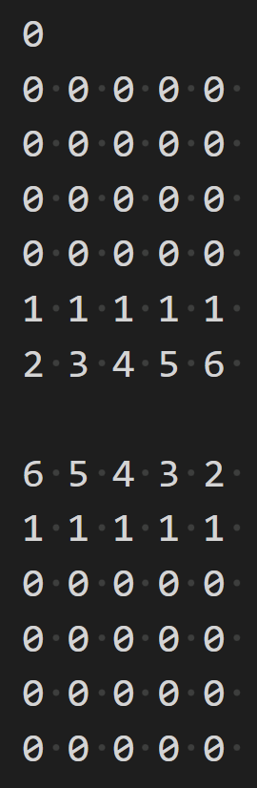
State file
3 part
First is the player (0 for white player, 1 for black player)
Second part is white player’s board (5*6)
Third part is black player’s board (5*6)
0=empty, 1=pawn, 2=rook, 3=knight, 4=bishop, 5=queen, 6=king

Slide 61
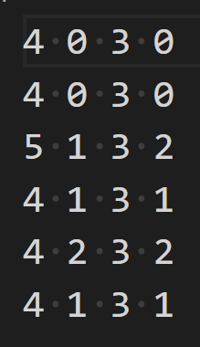
Action file
Your AI should output the next move to the action file
You can keep output moves in the time limit
Only the last complete output will be considered
In this case on the right, 4 1 3 1 will be accepted by game runner
You lose if you outputs an invalid move
Move format: from.y from.x to.y to.x
More details in package introduction section

Slide 62
How to design your AI
You can refer to the random.cpp/hpp in the src/policy and src/player folders
Design your state value function in state.cpp to evaluate the board
Implement Alpha-Beta Pruning method and use your value function in the search process
Run Alpha-Beta Pruning and decide which move to output

Slide 63
Outline
Introduction
Chess and Mini Chess
State Value Function
Minimax
Alpha-Beta Pruning
How To Design Your AI
Package
Requirements
Grading

Slide 64
Package
You don’t need to implement all the thing by yourself, we will provide some useful utilities and then you can focus on state value function and the tree search algorithm.

